Slide 1


SENSOR FUSION WITH CAMERA,RADAR
Prepared by:
R.Revanth Raj
P.Chaithanya
Hemasai
MAGIC@KARE

Slide 2
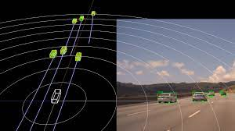
Radar based road user detection
A radar-based method for detecting moving road users which:
Multi-class(Pedestrians,cyclists and cars)
Provide classification both at the target and object level
Single-frame(does not need to accumulate sensor data over time)
The commercially available automotive radars output a 2D point-cloud of radar targets. Each target has a 2D position, a radial speed, and a Radar Cross Section value.
MAGIC@KARE

Slide 3
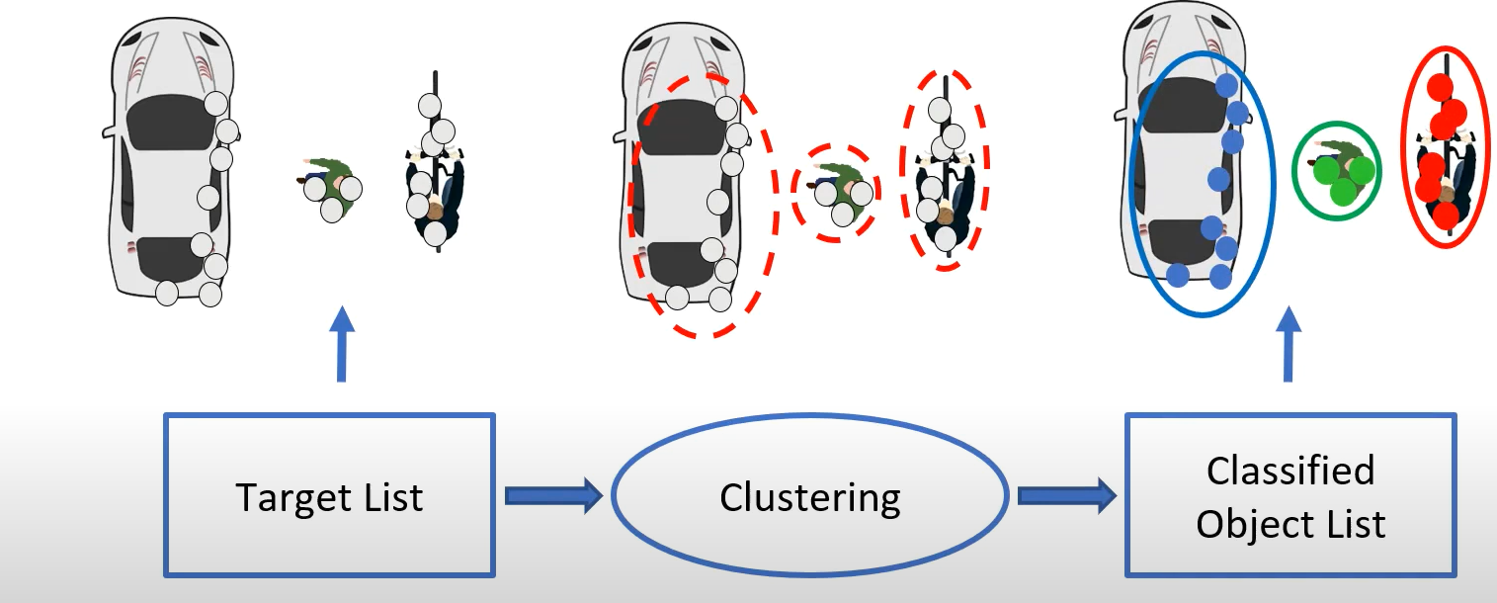
Conventional Pipeline
Features are extracted per cluster classification is done per cluster
MAGIC@KARE

Slide 4
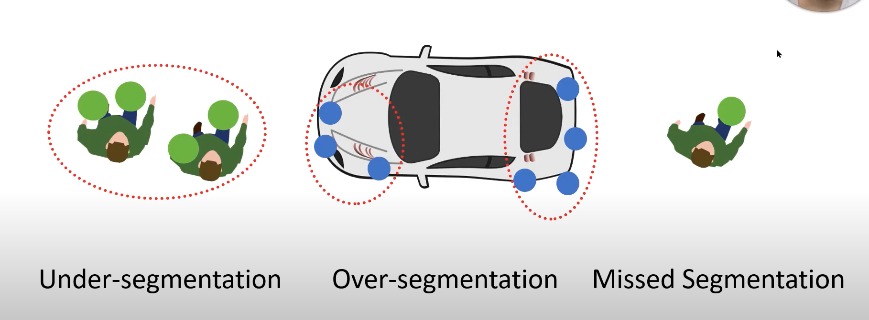
MAGIC@KARE

Slide 5
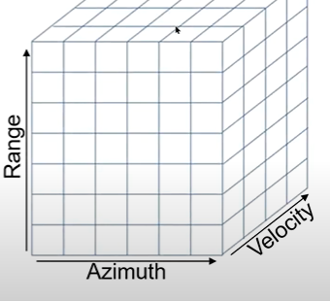
Radar Cube:
A lower level of radar data is called the radar cube.
It has three axes: range, azimuth, and velocity.
One cell represents reflectivity at:
That 2D position (range, azimuth index)
That speed(velocity index)
A column of the cube at a range-azimuth index contains the full velocity distribution at that 2D location
MAGIC@KARE

Slide 6
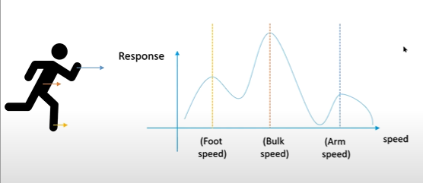
The speed distribution is class-characteristic, since it depends on what kind of moving parts does the object have.
A method that exploits this speed distribution for road user detection
MAGIC@KARE

Slide 7
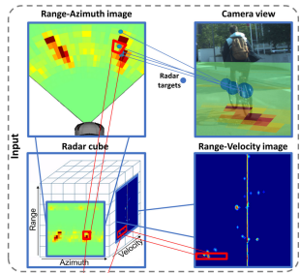
To exploit this low-level data, we:
Map the radar targets into the radar cube by their 2D location and velocity
2. Crop a 3D block around them
MAGIC@KARE

Slide 8
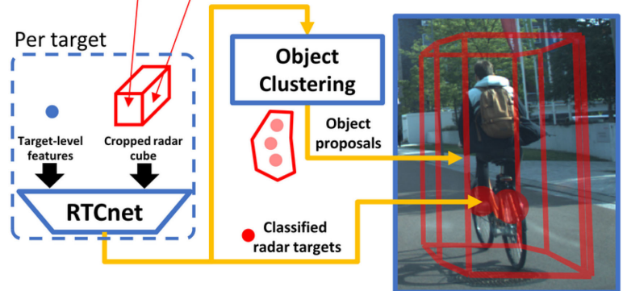
RTCnet:
RTCnet is a Convolutional Neural Network designed to classify each target individually into pedestrian ,cyclist ,car or other class
Afterwards, It will create object proposals in class-specific clustering
The advantage of class-specific clustering is that we can use different clustering parameters for each class
Eg: larger radius for cars
MAGIC@KARE

Slide 9
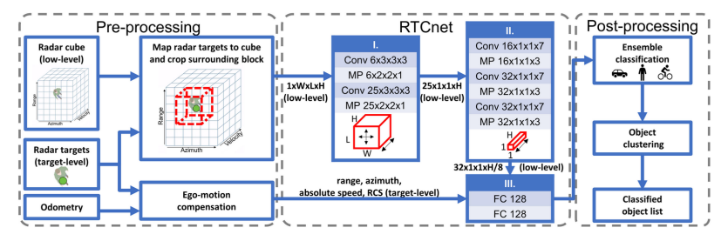
MAGIC@KARE

Slide 10
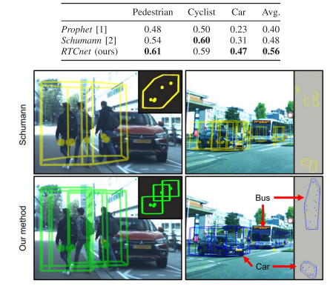
F1 SCORE OBJECT-WISE
MAGIC@KARE

Slide 11
Conclusion:
A radar based, single-frame, multiclass road user detection method. It exploits class information in low-level radar data by applying a specially designed neural network to a cropped block of the radar cube around each radar target and the target-level features.
A clustering step was introduced to create object proposals.
the proposed method outperforms the baselines overall in object-wise classification by yielding an average F1 score of 0.56
Temporal integration and/or tracking of objects could further improve the method’s performance and usability.
Reference:
Palffy, Andras, et al. "CNN based road user detection using the 3D radar cube." IEEE Robotics and Automation Letters 5.2 (2020): 1263-1270.
MAGIC@KARE

Slide 12
LITERATURE SURVEY
CenterTransFuser: radar point cloud and visual information fusion for 3D object detection Yan Li, Kai Zeng and Tao Shen*
CenterFusion: Center-based Radar and Camera Fusion for 3D Object Detection Ramin Nabati, Hairong Qi University of Tennessee Knoxville
Radar Voxel Fusion for 3D Object Detection Felix Nobis 1,* , Ehsan Shafiei 1 , Phillip Karle 1 , Johannes Betz 2 and Markus Lienkamp 1

Slide 13
THANK YOU
MAGIC@KARE

